Slide 1



Wireless Infrastructure Components

Slide 2
Wireless Infrastructure Components
Introduction
Wireless LAN Concepts
Ad Hoc vs. Infrastructure
3. Summary

Slide 3
Objectives
▪▪ Describe wireless technology and standards.
▪▪ Describe the components of a wireless infrastructure.
▪▪ Describe wireless topologies.

Slide 4
Wireless Concepts

Slide 5
Supporting Mobility
Wireless Infrastructure Components
▪▪ Productivity is no longer restricted to a fixed work location or a defined time period.
▪▪ People now expect to be connected at any time and place, from the office to the airport or the home.
▪▪ Users now expect to be able to roam wirelessly.
▪▪ Roaming enables a wireless device to maintain Internet access without losing a connection.

Slide 6

Benefits of Wireless
Wireless Infrastructure Components
▪▪ Increased flexibility
▪▪ Increased productivity
▪▪ Reduced costs
▪▪ Ability to grow and adapt to changing requirements

Slide 7
Wireless Technologies
Wireless Infrastructure Components
Wireless networks can be classified broadly as:
▪▪ Wireless personal-area network (WPAN) – Operates in the range of a few feet (Bluetooth).
▪▪ Wireless LAN (WLAN) – Operates in the range of a few hundred feet.
▪▪ Wireless wide-area network (WWAN) – Operates in the range of miles.
▪▪ Bluetooth – An IEEE 802.15 WPAN standard; uses a device- pairing process to communicate over distances up to .05 mile (100m).
▪▪ Wi-Fi (wireless fidelity) – An IEEE 802.11 WLAN standard; provides network access to home and corporate users, to include data, voice and video traffic, to distances up to 0.18 mile (300m).

Slide 8
Wireless Technologies (cont.)
Wireless Infrastructure Components
▪▪ Worldwide Interoperability for Microwave Access (WiMAX) – An IEEE 802.16 WWAN standard that provides wireless broadband access of up to 30 mi (50 km).
▪▪ Cellular broadband – Consists of various corporate, national, and international organizations using service provider cellular access to provide mobile broadband network connectivity.
▪▪ Satellite Broadband – Provides network access to remote sites through the use of a directional satellite dish.

Slide 9
Wireless Infrastructure Components
Wi-Fi Certification
The Wi-Fi Alliance certifies Wi-Fi and the following product compatibility:
▪▪ IEEE 802.11a/b/g/n/ac/ad-compatible.
▪▪ IEEE 802.11i secure using WPA2™ and Extensible Authentication Protocol (EAP)
▪▪ Wi-Fi Protected Setup (WPS) to simplify device connections.
▪▪ Wi-Fi Direct to share media between devices
▪▪ Wi-Fi Passpoint to simplify securely connecting to Wi-Fi hotspot networks
▪▪ Wi-Fi Miracast to seamlessly display video between devices

Slide 10
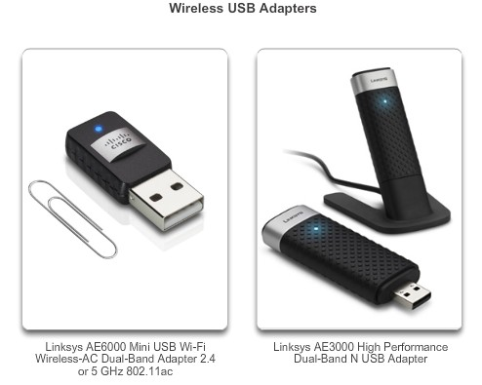
Wireless NICs
Wireless Infrastructure Components
Wireless deployment requires:
▪▪ End devices with wireless NICs
▪▪ Infrastructure device, such as a wireless router or wireless AP
10

Slide 11
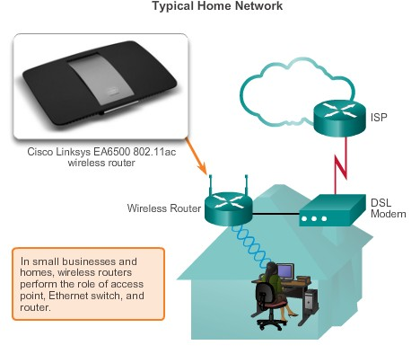
Wireless Home Router
Wireless Infrastructure Components
A home user typically interconnects wireless devices using a small, integrated wireless router.
These serve as:
▪▪ access point
▪▪ Ethernet switch
▪▪ router

Slide 12
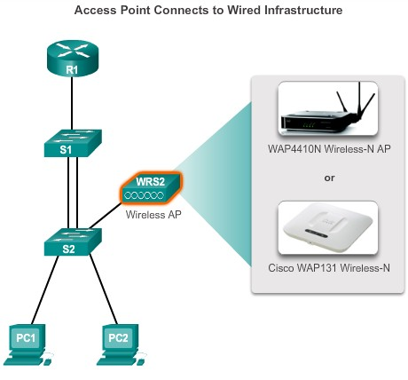
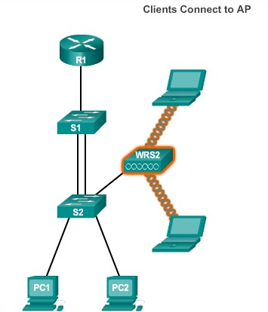
Business Wireless Solutions
Wireless Infrastructure Components
Figure 1
Figure 2

Slide 13
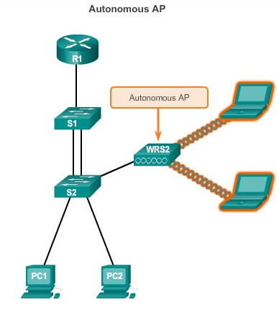
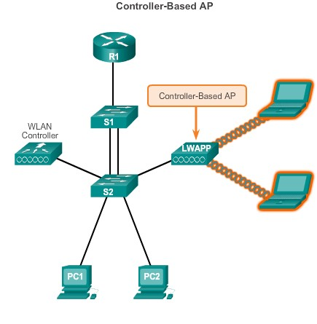
Wireless Access Points
Wireless Infrastructure Components

Slide 14
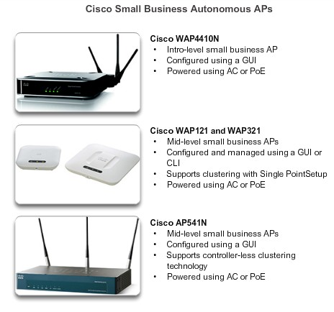
Wireless Infrastructure Components
Small Wireless Deployment Solutions

Slide 15
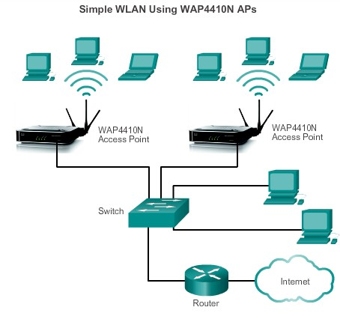
Small Wireless Deployment Solutions (cont.)
Wireless Infrastructure Components
▪▪ Each AP is configured and managed individually.
▪▪ This can become a problem when several APs are required.

Slide 16
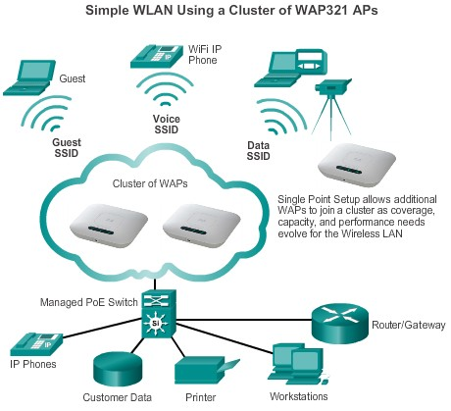
Small Wireless Deployment Solutions
Wireless Infrastructure Components
▪▪ Support the clustering of APs without the use of a controller.
▪▪ Multiple APs can be deployed and pushed to a single configuration to all devices within the cluster, managing the wireless network as a single system without worrying about interference between APs, and without configuring each AP as a separate device.

Slide 17
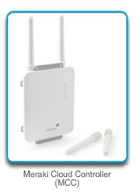
Large Wireless Deployment Solutions
Wireless Infrastructure Components
▪▪ For larger organizations with many APs, Cisco provides controller-based managed solutions, including the Cisco Meraki Cloud Managed Architecture and the Cisco Unified Wireless Network Architecture.
▪▪ Cisco Meraki cloud architecture is a management solution used to simplify the wireless deployment.
Using this architecture, APs are
centrally managed from a controller in the cloud.

Slide 18
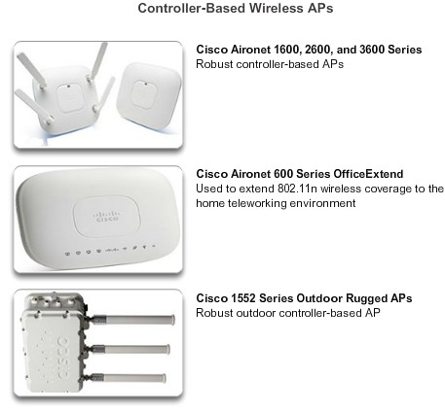
Wireless Infrastructure Components
Large Wireless Deployment Solutions (cont.)

Slide 19
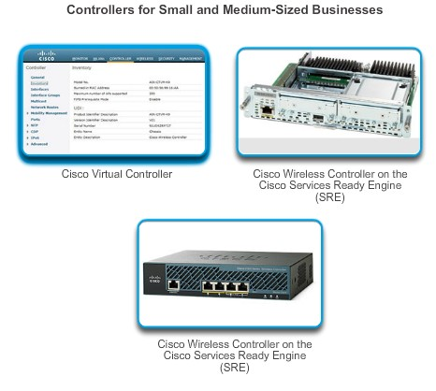
Wireless Infrastructure Components
Large Wireless Deployment Solutions (cont.)

Slide 20
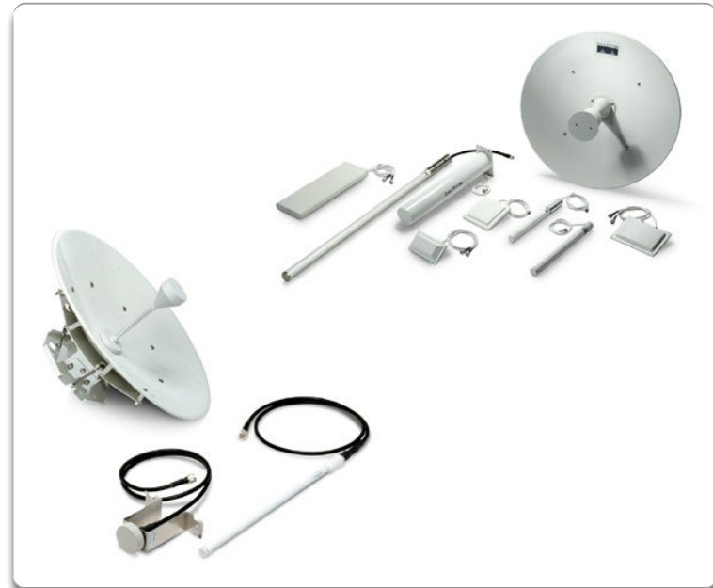
Wireless Antennas
Wireless Infrastructure Components
Cisco Aironet APs can use:
▪▪ Omnidirectional Wi-Fi Antennas – Factory Wi- Fi gear often uses basic dipole antennas, also referred to as “rubber duck” design, similar to those used on walkie-talkie radios.
Omnidirectional antennas provide 360-degree coverage.
▪▪ Directional Wi-Fi Antennas – Directional antennas focus the radio signal in a given direction, which enhances the signal to and from the AP in the direction the antenna is pointing.
▪▪ Yagi antennas – Type of directional radio antenna that can be used for long-distance Wi-Fi networking.
20

Slide 21
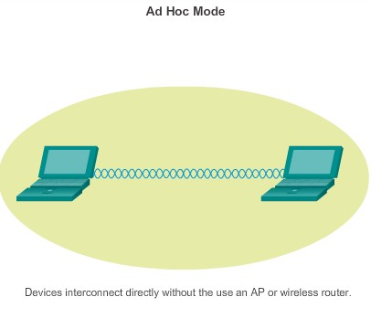
802.11 Wireless Topologies
802.11 Wireless Topology Modes

Slide 22
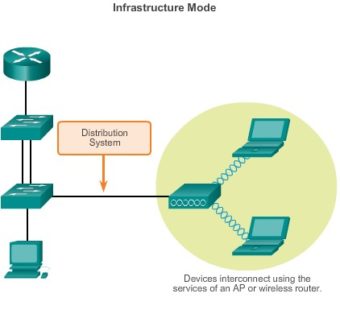
802.11 Wireless Topology Modes (cont.)
802.11 Wireless Topologies

Slide 23
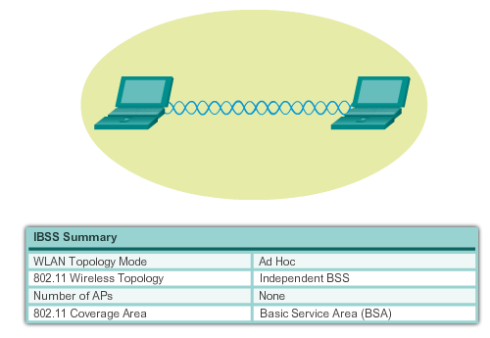
802.11 Wireless Topologies
Ad Hoc Mode
Tethering (personal hotspot) – Variation of the Ad Hoc topology when a smart phone or tablet with cellular data access is enabled to create a personal hotspot.

Slide 24
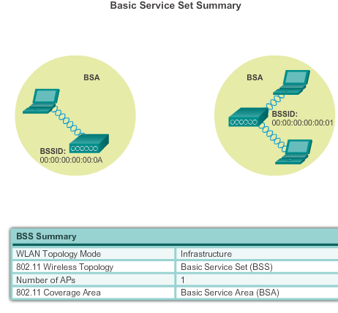
802.11 Wireless Topologies
Infrastructure Mode

Slide 25
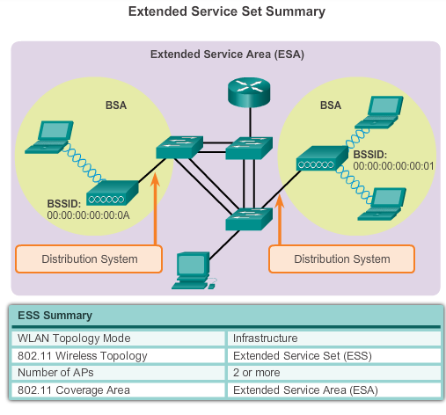
Infrastructure Mode (cont.)
802.11 Wireless Topologies

Slide 26
Summary
▪▪ WLANs are often implemented in homes, offices, and campus environments.
▪▪ Only the 2.4, GHz, 5.0 GHz, and 60 GHz frequencies are used for
802.11 WLANs.
▪▪ The Wi-Fi Alliance certifies that vendor products conform to industry standards and norms.
▪▪ A STA uses a wireless NIC to connect to an infrastructure device such as a wireless router or wireless AP.
▪▪ STAs connect using an SSID.
▪▪ APs can be implemented as standalone devices, in small clusters, or in a larger controller-based network.

Slide 27
Summary
▪▪ A Cisco Aironet AP can use an onmidirectional antenna, a directional antenna, or a yagi antenna to direct signals.
▪▪ IEEE 802.11n/ac/ad use MIMO technology to improve throughput and support up to four antennas, simultaneously.
▪▪ In ad-hoc mode or IBSS, two wireless devices connect to each other in a P2P manner.
▪▪ In infrastructure mode, APs connect to network infrastructure using the wired DS.
▪▪ Each AP defines a BSS and is uniquely identified by its BSSID.
▪▪ Multiple BSSs can be joined into an ESS.
▪▪ Using a particular SSID in an ESS provides seamless roaming capabilities among the BSSs in the ESS.

